Slide 1
Install Composer for Acquia Dev Desktop (Mac)
Patrick Fobes

Slide 2
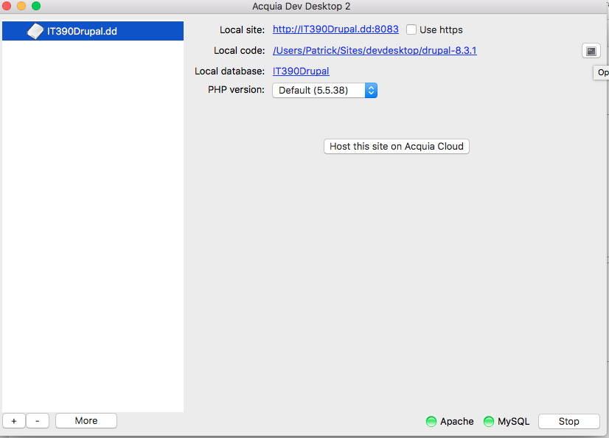
Click on the button to open terminal

Slide 3
In terminal, install Brew
ruby -e "$(curl -fsSL https://raw.githubusercontent.com/Homebrew/install/master/install)"
Next, update Brew
“brew update”
“brew tap homebrew/dupes”
”brew tap homebrew/php”
”brew install php56”
“brew install composer”
To test installation:
“composer –V”
Now composer is installed
Credit: https://gist.github.com/tomysmile/3b37ab4a1ddd604093fe724d0a882166

Slide 4
Install Drupal 8 Address Module
In the Terminal application run the 2 commands:
Add the Drupal.org repositoiry
composer config repositories.drupal composer https://packages.drupal.org/8
Download Address module
composer require “drupal/address ~1.0

Slide 5
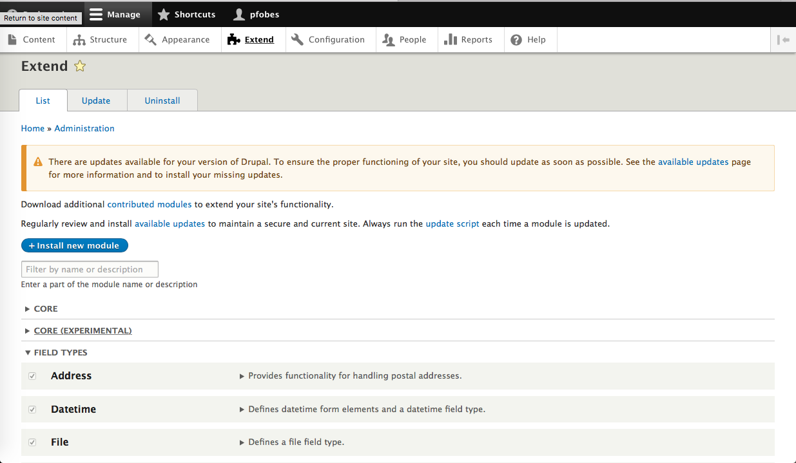
Now, activate the module

